Slide 1

COMPREHENSIVE ANALYSIS OF FINANCIAL PERFORMANCE:INSIGHTS FROM A LEADING BANKS

Slide 2
TEAM ID:NM2023TMID01881
TEAM LEADER: R.SUSHMITHA
TEAM MEMBERS: A.SUBASHIRI
M.SAFRIN SABANA
N.NIVETHA

Slide 3
INTRODUCTION
Financial performance analysis includes analysisand interpretation of financial statements in such a way that it undertakes a full diagnosis of the profitability and financial soundness of the business,
Financial statement provide a formal record of a business financial activities and position.

Slide 4
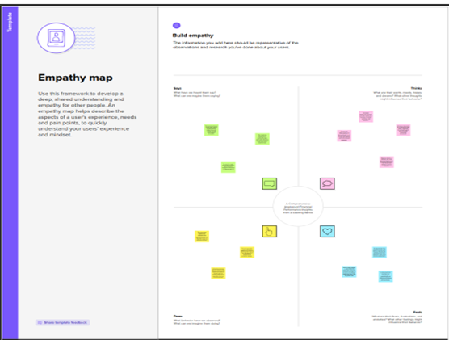
PROBLEM DEFINITION & DESIGN THINKING EMPATHY MAP

Slide 5
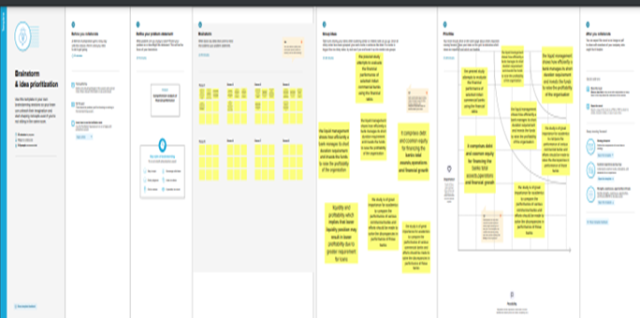
IDEATION & BRAIN STROMING

Slide 6
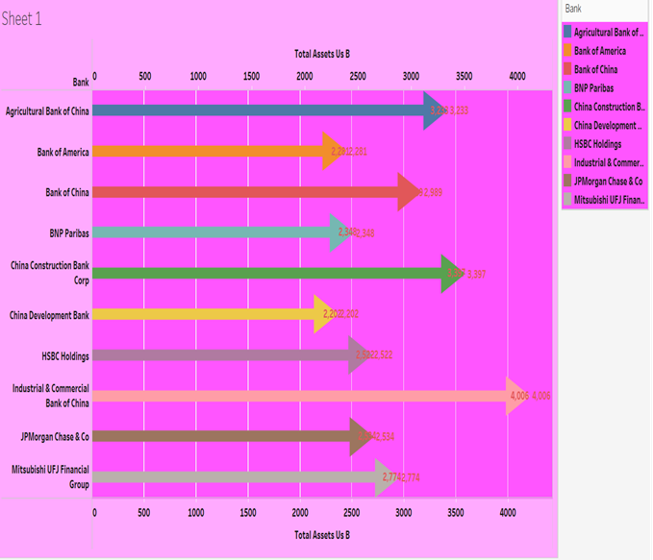
RESULT SHEET 1
TOP BANKS ACCORDING TO RANK AND ASSESTS

Slide 7
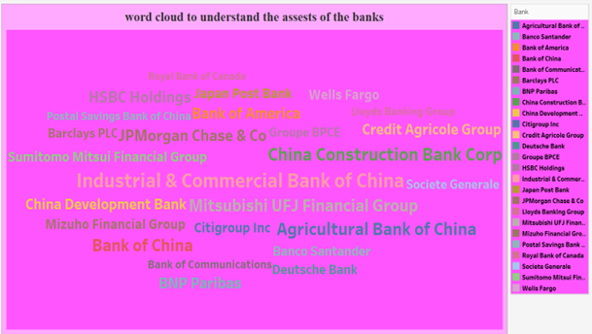
RESULT SHEET 2
TOP BANKS ACCORDING TO TOTAL ASSESTS

Slide 8
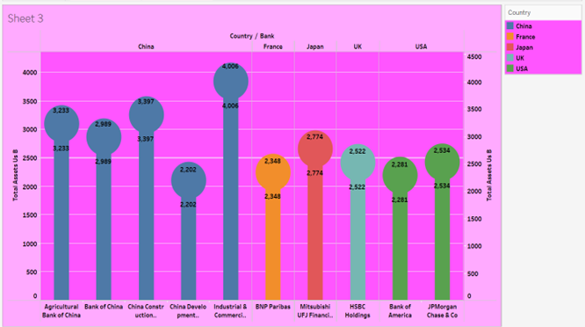
RESULT SHEET 3
TOP BANKS ACCORDING TO COUNTRY BASED ON TOTAL ASSESTS

Slide 9
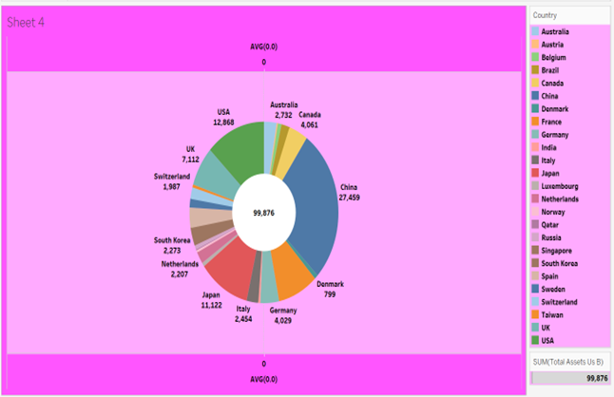
SHEET 4
TOP 10 COUNTRIESWITH ASSESTS PROPORTION

Slide 10
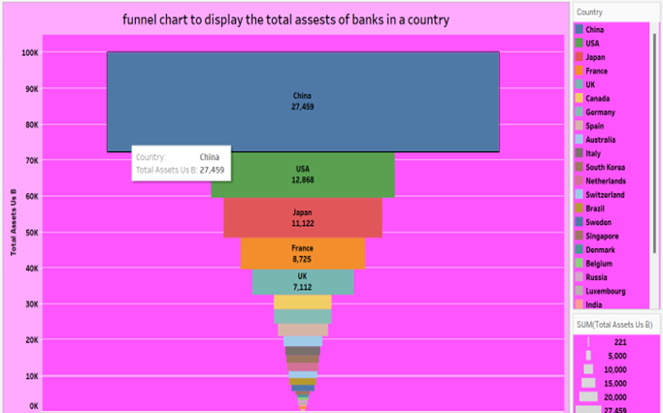
SHEET 5
COUNTRY WITH TOTAL ASSESTS USING FUNNEL CHART IN INCREASING ORDER

Slide 11
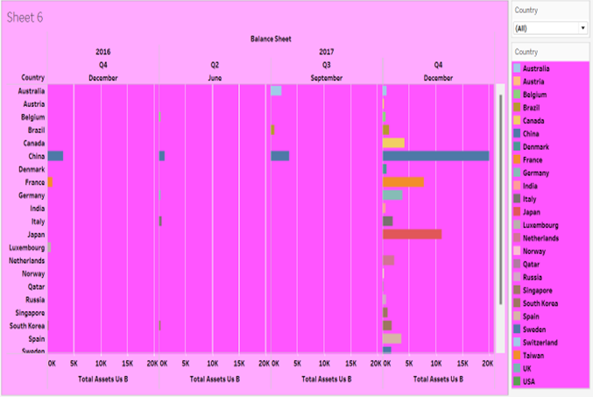
SHEET 6
TOTAL ASSESTS ANALYSIS ACCORDING TO YEAR AND QUARTER

Slide 12
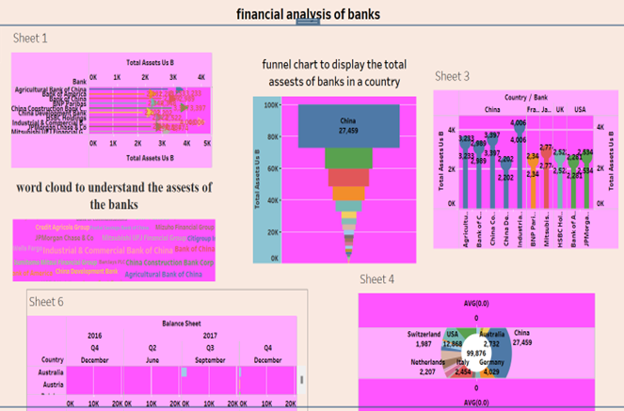
DASHBOARD

Slide 13
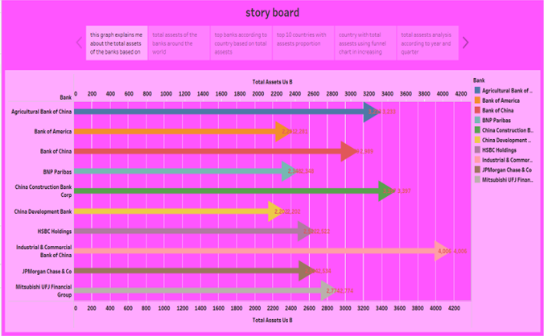
STORY 1

Slide 14
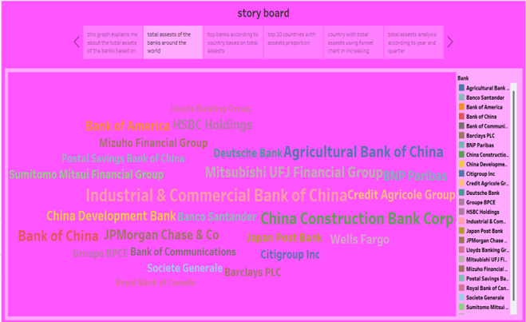
STORY 2

Slide 15
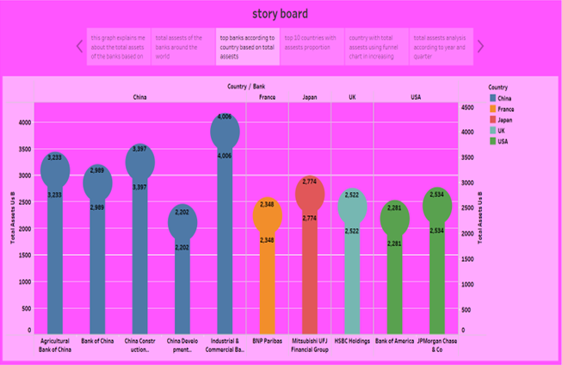
STORY 3

Slide 16
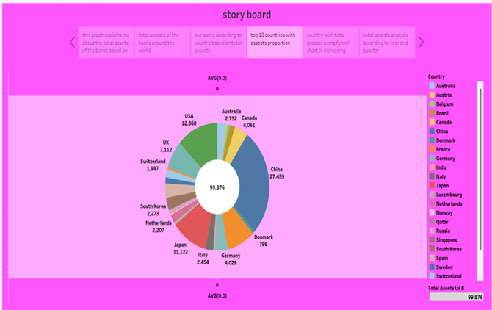
STORY 4

Slide 17
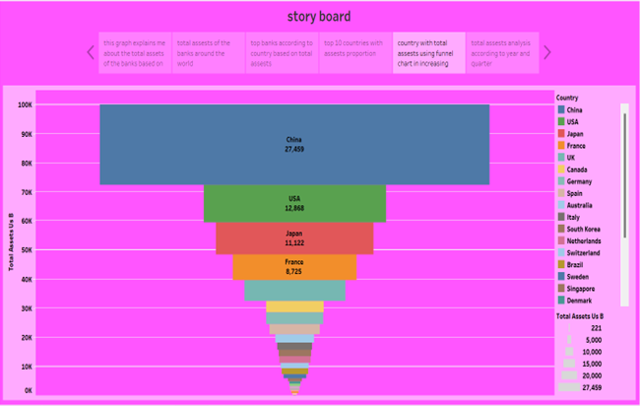
STORY 5

Slide 18
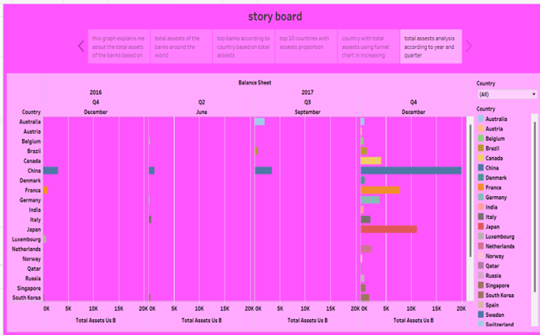
STORY 6

Slide 19
ADVANTAGES
It provides an overview of how well the company manages its assets and liabilities.
Analysts can find information about long-term vs. short-term debt on the balance sheet.
They can also find information about what kind of assets the company owns and what percentage of assets are financed with liabilities vs.

Slide 20
DISADVANTAGES
The financial analysis does not consider cost-price level changes.
The financial analysis is ambiguous if the prior knowledge of the changes in accounting procedure followed by the company is not known.

Slide 21
FUTURE SCOPE
Analyze financial ratios to assess profitability, solvency, working capital management, liquidity, and operating effectiveness.
Compare current performance with historical conditions using trend analysis.
Compare with peer companies or industry averages to find out how well companies are performing.

